Slide 1
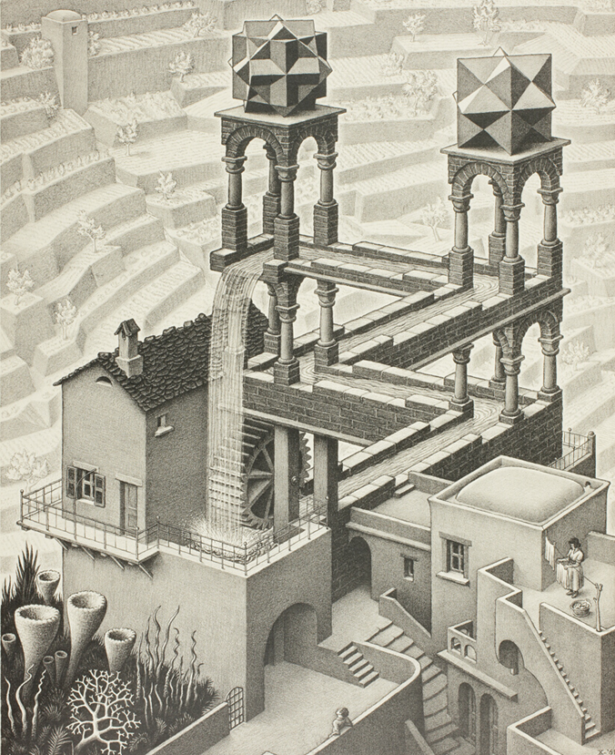

4 current perspectives on Circular Economy & influential predecessors
IL “Introduction to Circular Economy” WS 24-25
Kami Höferl
(Escher, 1961)

Slide 2
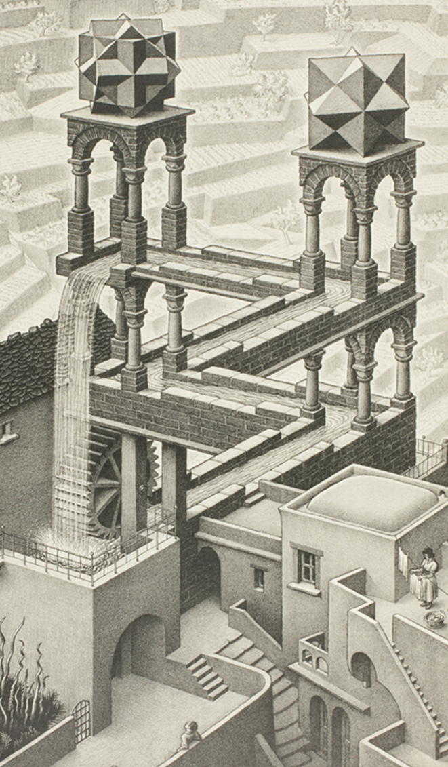
Overview
One size fits all in CE?
Influential predecessors
From Industrial Ecology to …
Regenerative Design …
… & beyond
(Escher, 1961)
(Escher, 1961)

Slide 3
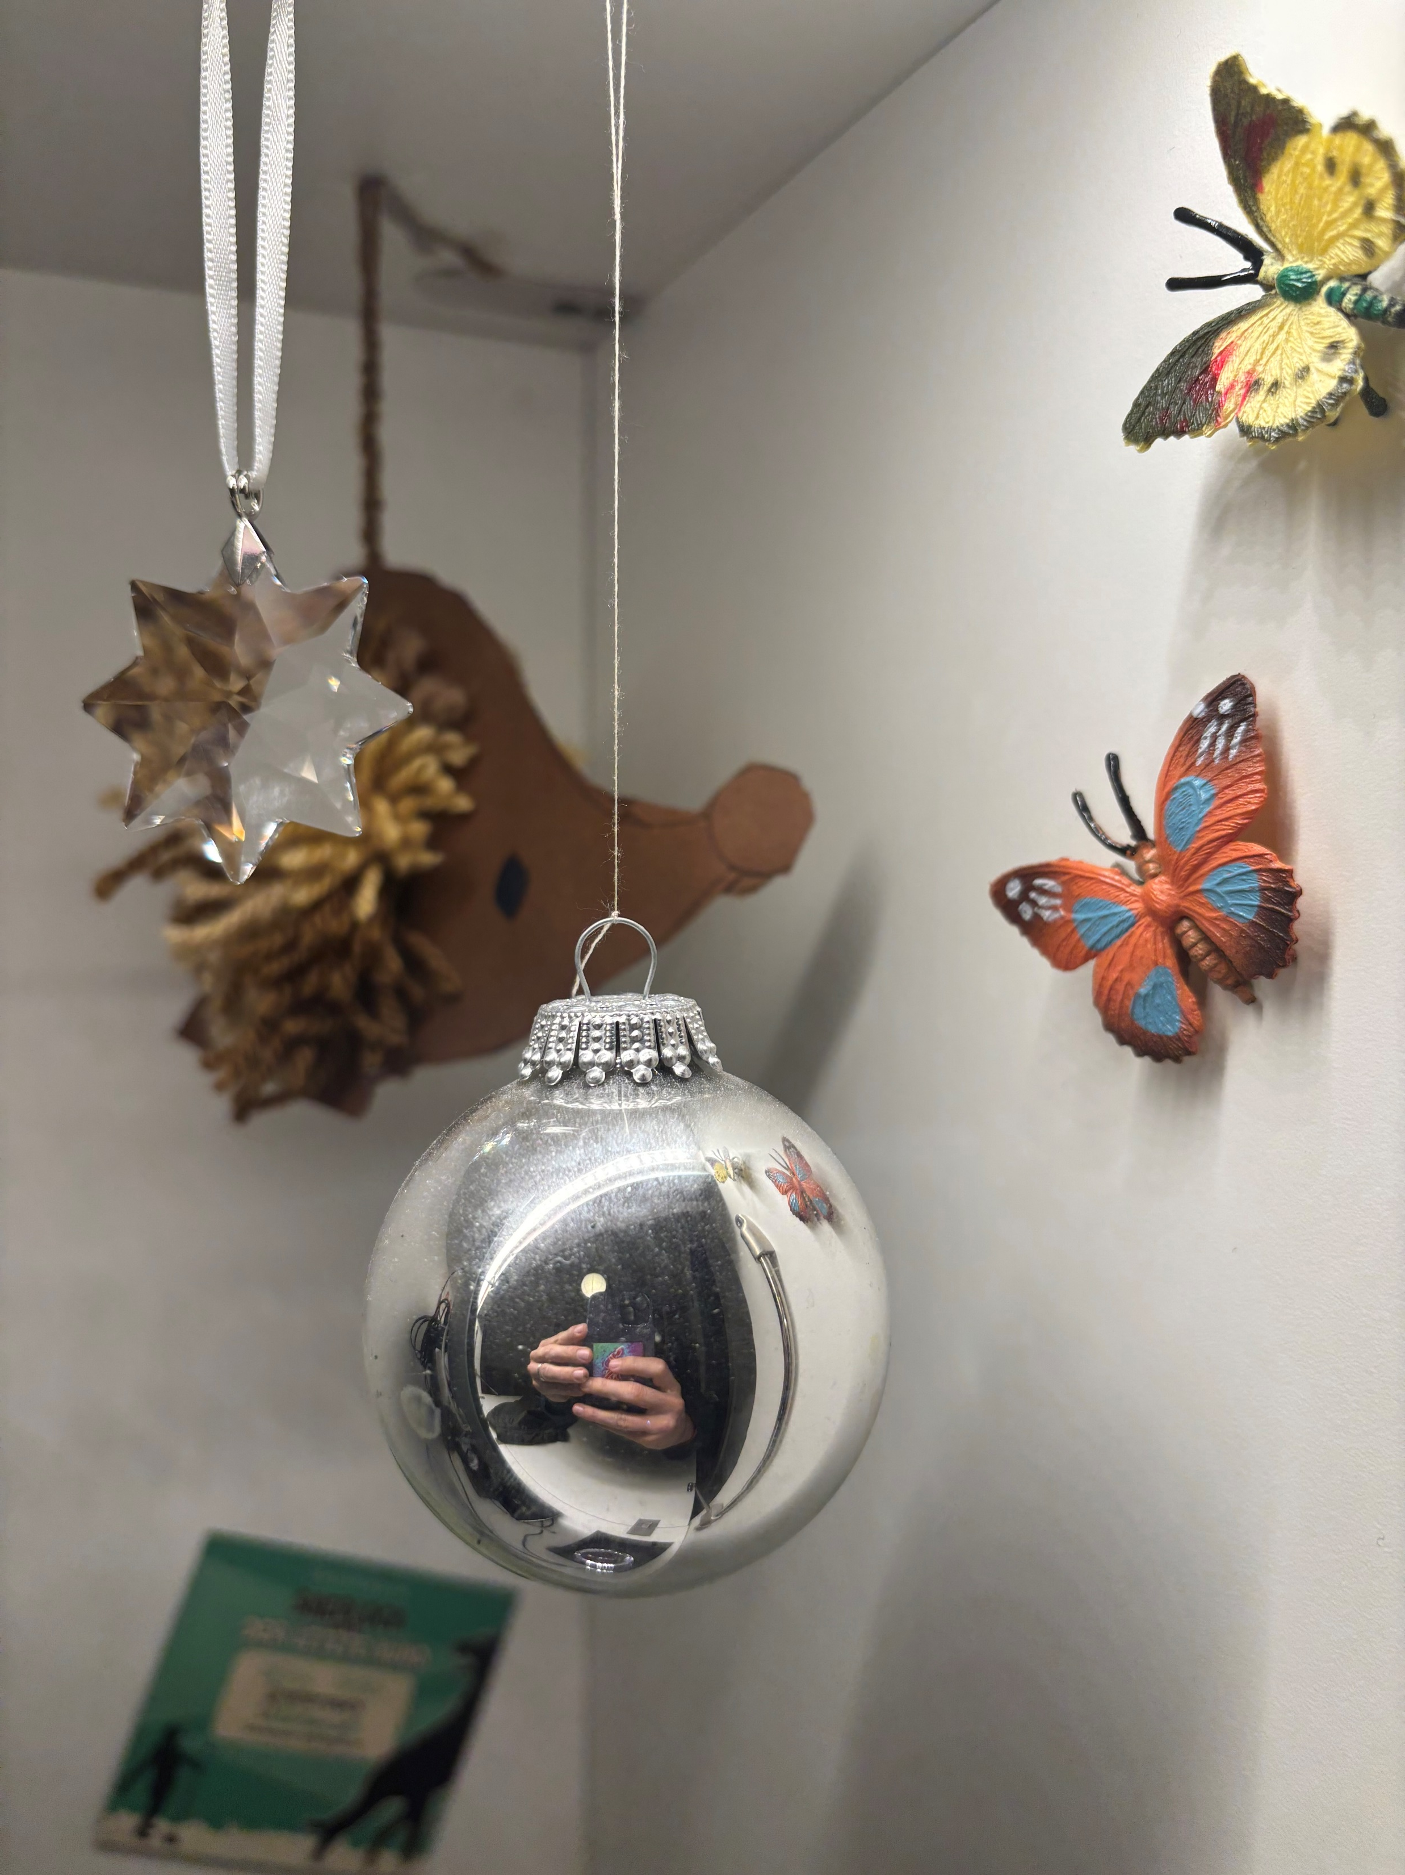
BTW: Thanks again

Slide 4
One size fits all?

Slide 5
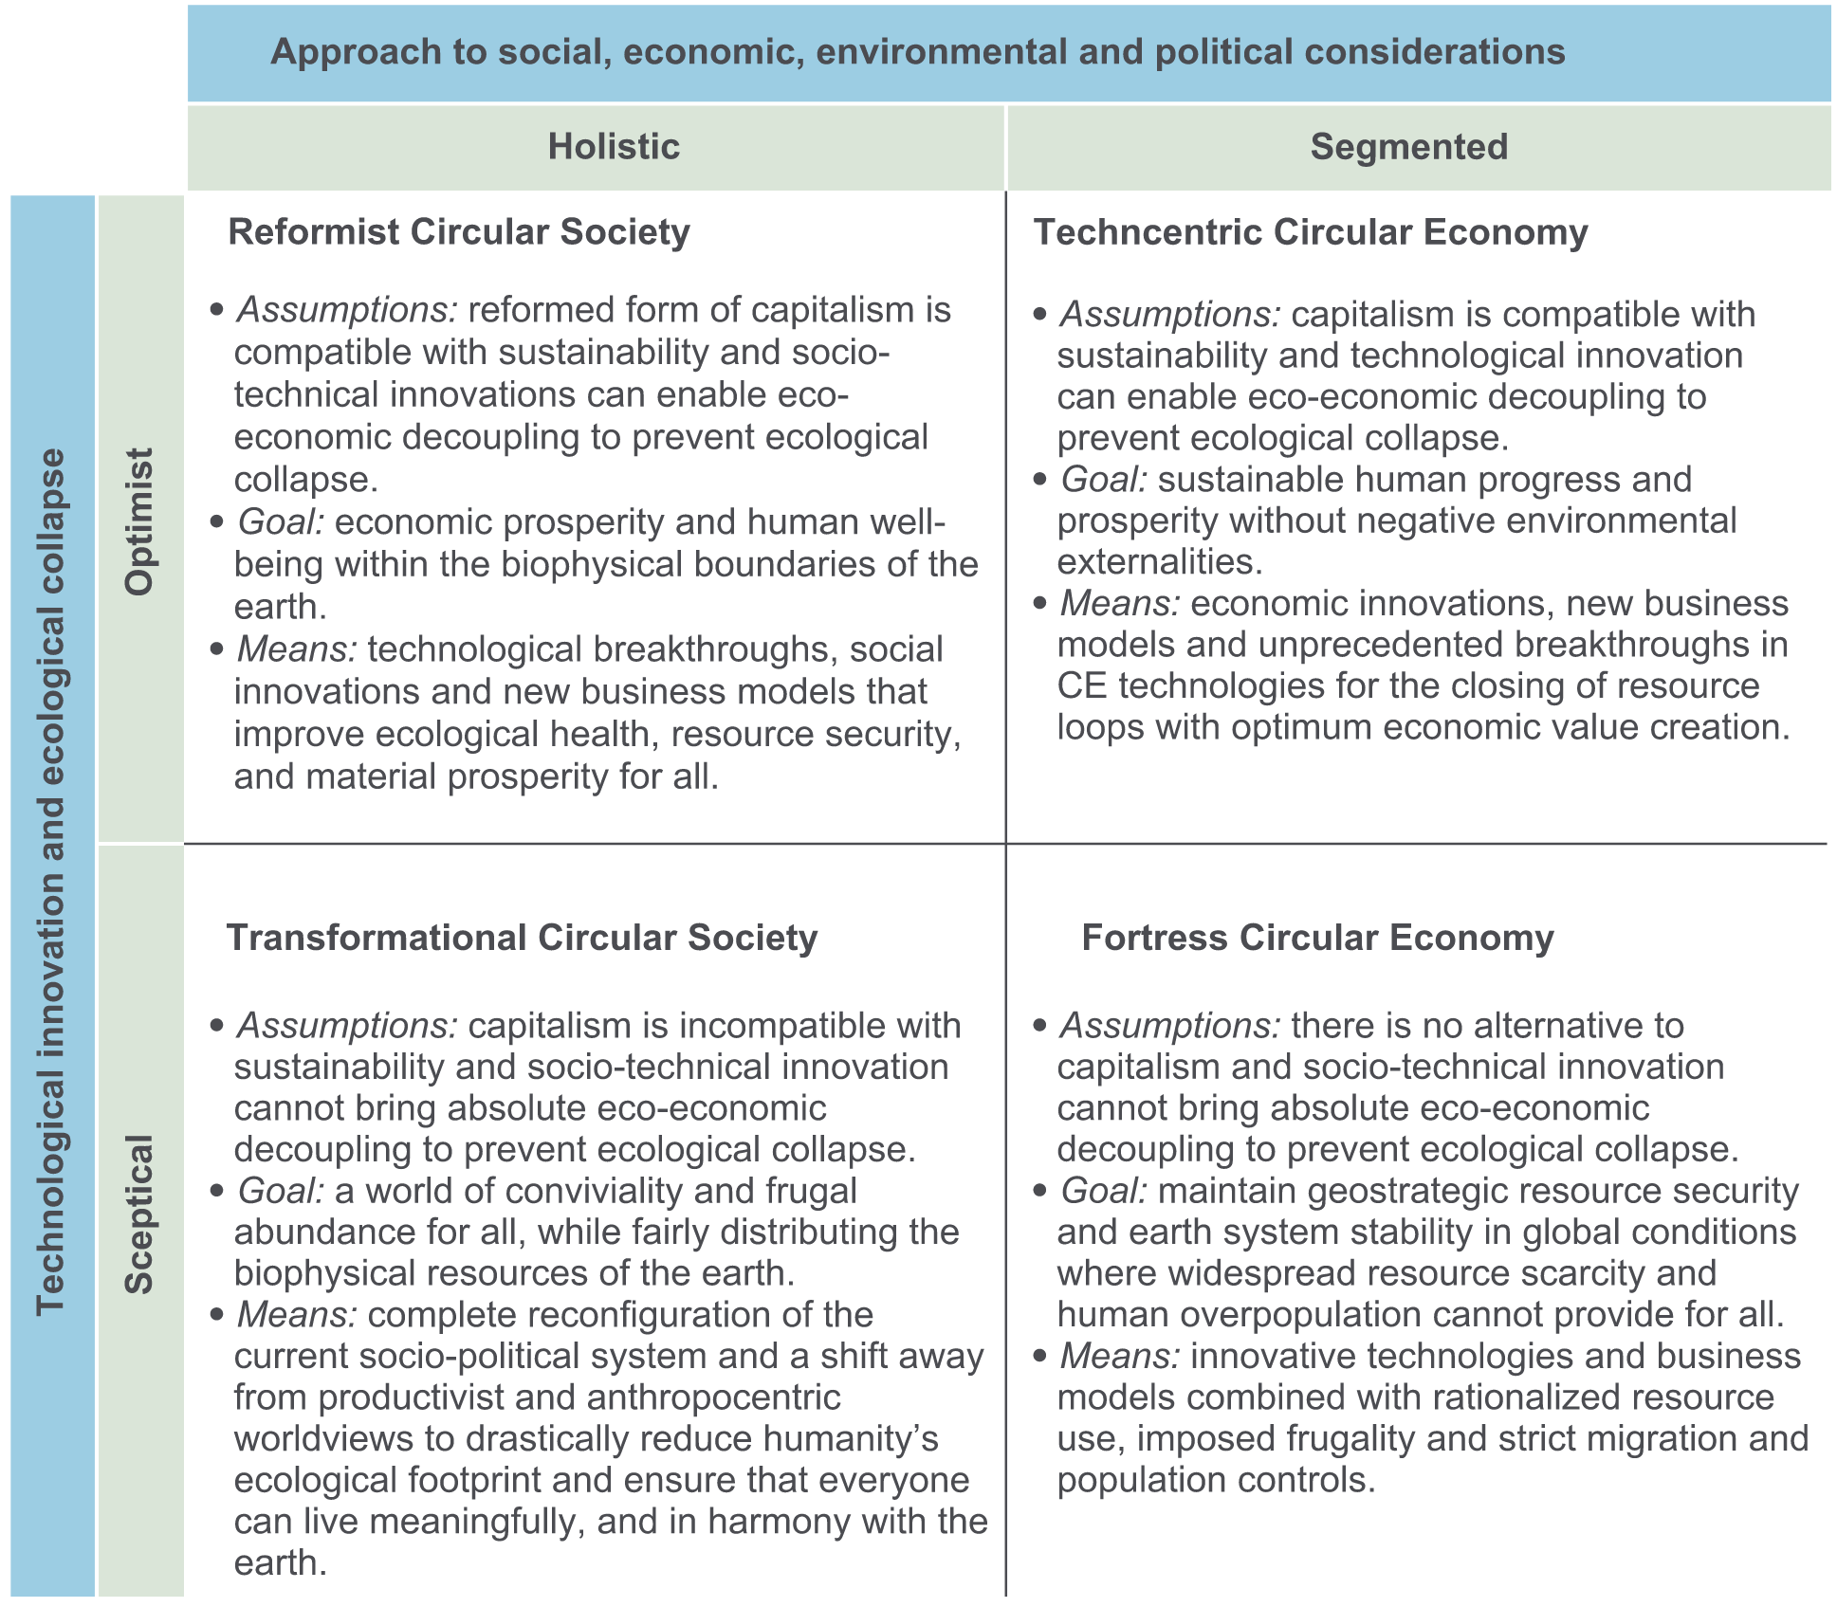
Revisiting the (theoretical) critique of conceptual fragmentation: Friant et al. (2020)

Slide 6
Friant et al.‘s (2020) Technocentric Circular Economy
👉 technological innovation & market-driven solutions
Key Strategies:
Innovation: Eco-design for durable, repairable, and recyclable products
Industrial symbiosis to optimise resource use between industries
Recycling and efficient resource management, refurbish to recover
Goals: Win-Win Green growth and decoupling economic growth from environmental harm
Strengths:
Promotes innovation and efficiency, compatible with existing capitalist systems
Criticisms:
Overlooks social justice and equity, limited focus on behavioural and systemic changes

Slide 7
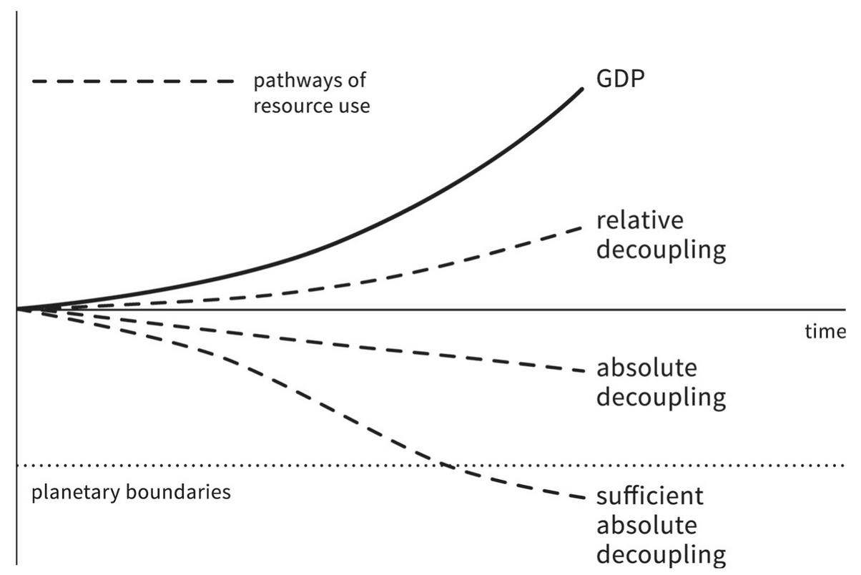
Friant et al.‘s (2020) Technocentric Circular Economy & its perspective on decoupling

Slide 8
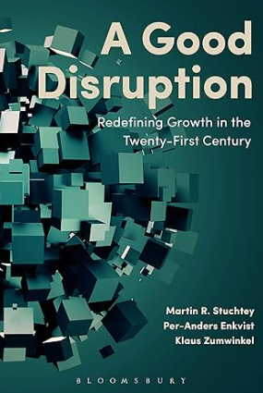
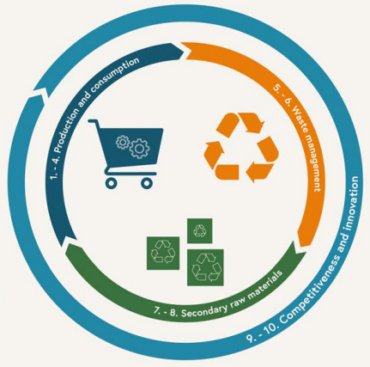


Friant et al.‘s (2020) Technocentric Circular Economy
Notes:
Bis Min 9

Slide 9
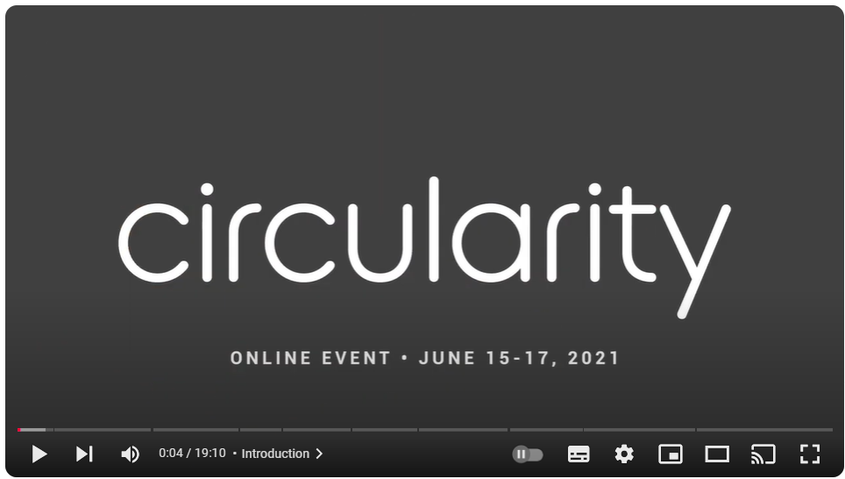
Friant et al.‘s (2020) Technocentric Circular Economy
Notes:
Bis Min 9

Slide 10
Friant et al.‘s (2020) Reformist Circular Society
👉 Vision: A fair, abundant, and sustainable society.
Eco-Economic Decoupling: Aligns sustainability with economic growth.
Systemic Innovation: Driven by socio-economic, industrial, and env. advancements.
Key Strategies:
Technological solutions: Eco-design, industrial symbiosis, product-service systems (PSS) & biomimicry
Circular Loops: reuse, repair, refurbish, remanufacture, repurpose & recycle
Stakeholder collaboration & policy alignment
Goals:
reform capitalism, not dismantling it
Fairness & equity 👉 participatory governance
Prevent collapse 👉 staying within planetary boundaries
Notes:
Circle economy, Club of Rome

Slide 11
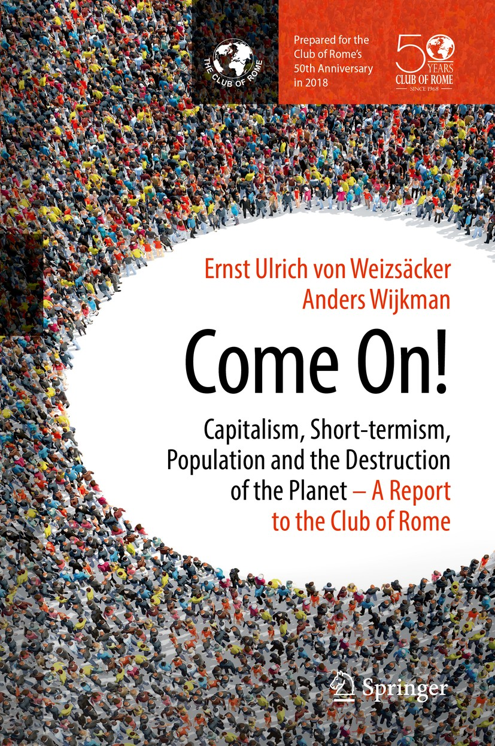
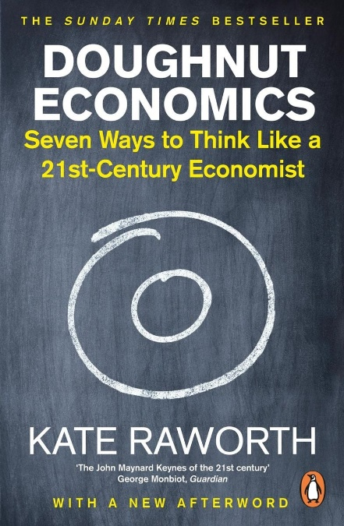
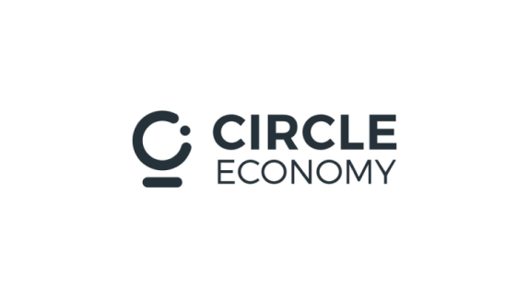

Friant et al.‘s (2020) Reformist Circular Society

Slide 12
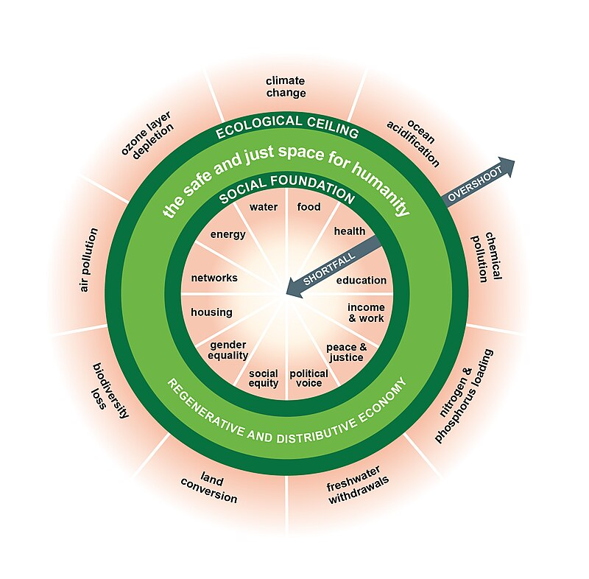
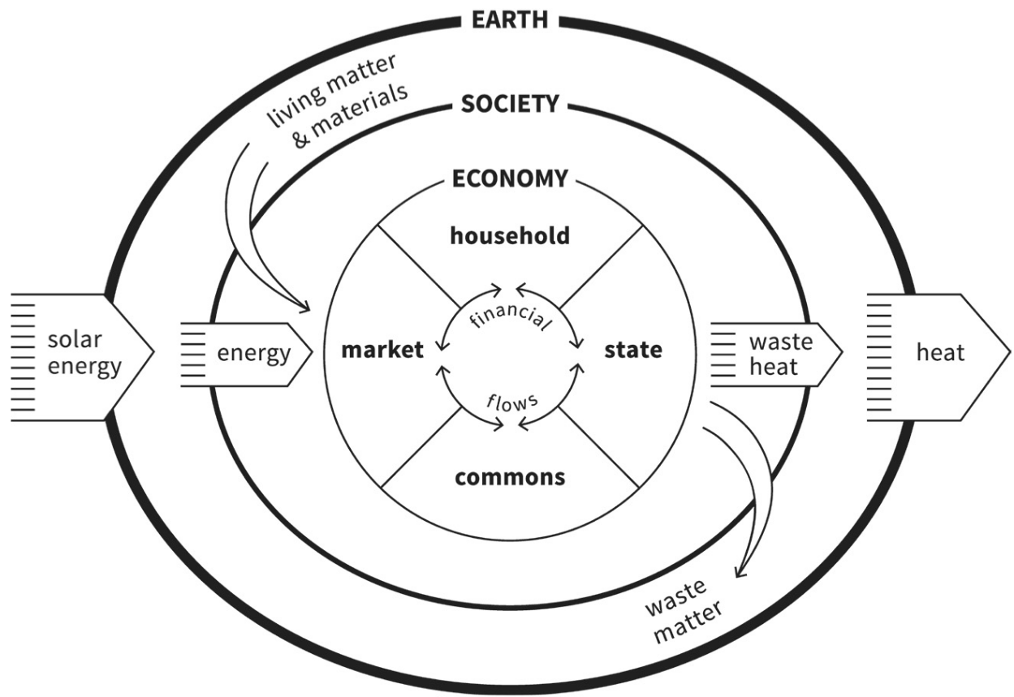
Digression: Raworth’s (2017) “Doughnut Economics”

Slide 13
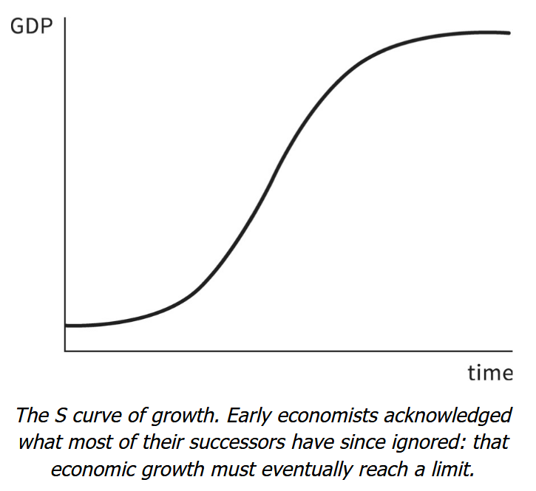
Friant et al.‘s (2020) Reformist Circular Society & its perspective on growth

Slide 14
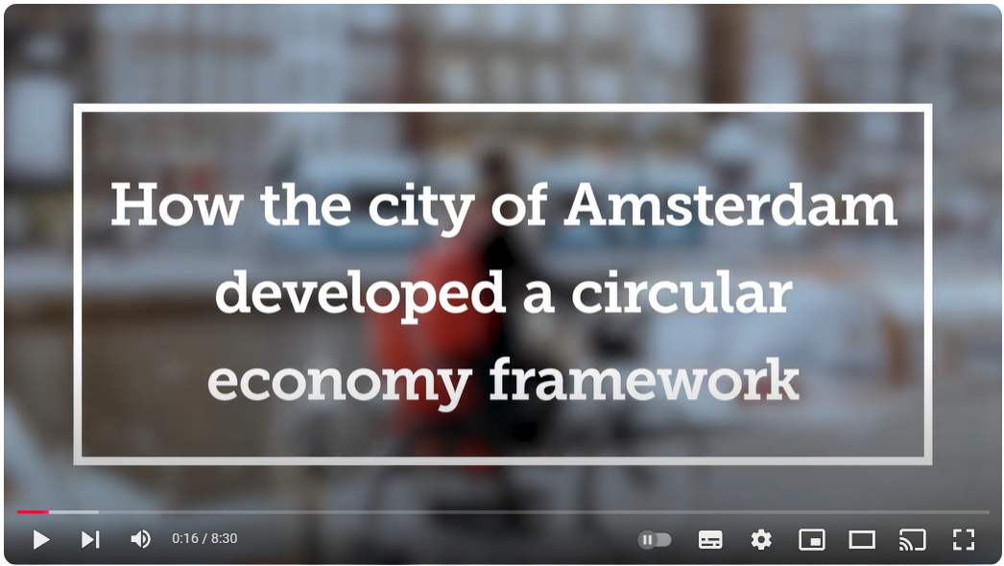
Friant et al.‘s (2020) Reformist Circular Society

Slide 15
Friant et al.‘s (2020) Transformational Circular Society
👉 Systemic transformation: post-capitalist society focused on sufficiency, simplicity & localisation
Social equity: fair distribution of resources & power = just & regenerative
Harmony with Nature: human wellbeing > economic growth
Key Strategies:
Sufficiency & simplicity: refuse, reduce, reuse, repair, refurbish
Localised production & participatory governance
Cultural shift: care, stewardship & mutualism with nature
Goals: from growth-based to well-being-focused systems
Empower local communities 👉 justice, collaboration & regeneration

Slide 16
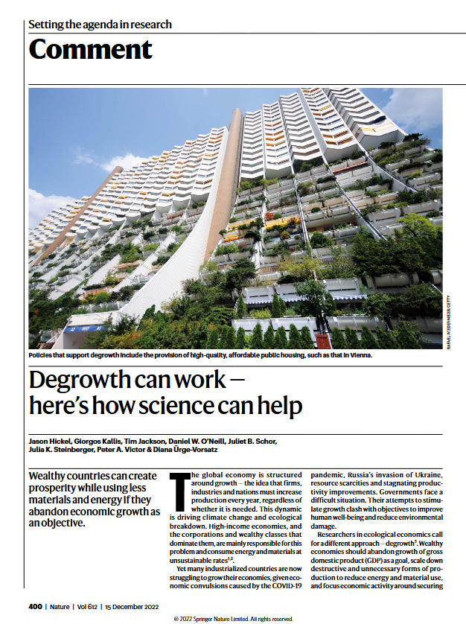
Digression: Degrowth?
👉 economic & social movement advocating for reducing consumption & production to achieve ecological sustainability & social well-being
Principles:
Sufficiency: Prioritise "enough"
Redistribution: Fairness in resource use & wealth distribution
Localisation: Support local economies
Ecological Regeneration: Restore ecosystems 👉 prioritise long-term environmental health
Critique: challenging current economic structures = unrealistic

Slide 17
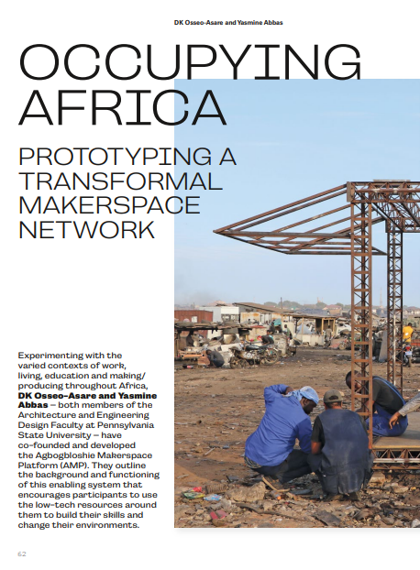
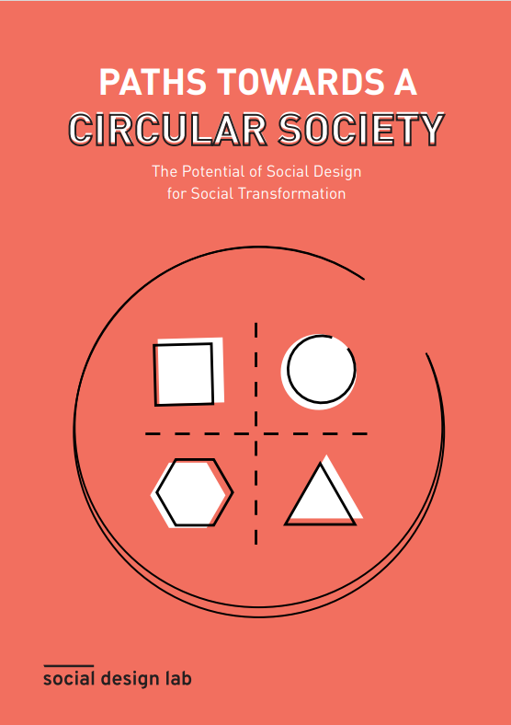

Friant et al.‘s (2020) Transformational Circular Society
Notes:
Hans Sauer

Slide 18
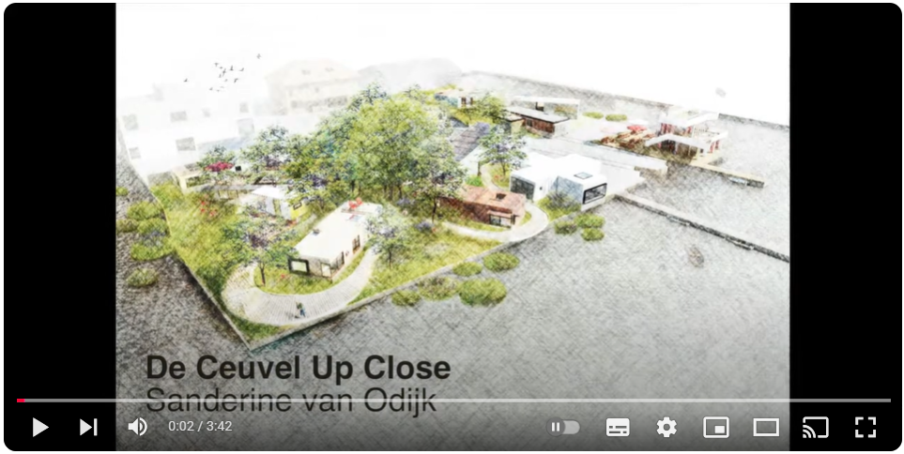
Friant et al.‘s (2020) Transformational Circular Society

Slide 19
Friant et al.‘s (2020) Fortress Circular Economy
👉 Top-down resource control: centralised management
Scarcity management: control key resources to avoid collapse
Exclusionary approach: interest of selected few 👉 neglect social equity & inclusivity
Key strategies:
Old School: Population control
Resource allocation: Centralised governance for “efficient” use
Exclusion policies: limited resource access
Technocratic solutions: innovation & efficiency
Goals: avoid resource scarcity 👉 societal (= economical) collapse
Preserve stability & order (for subgroups) 👉 maintain elite power structures
Notes:
All Rs included

Slide 20
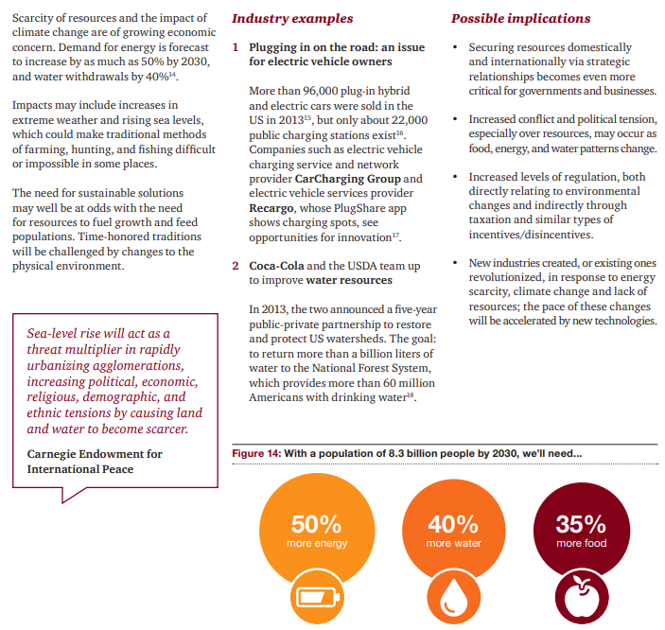
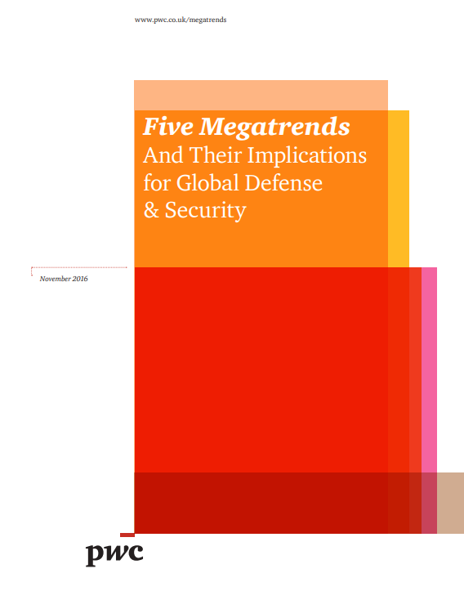
Friant et al.‘s (2020) Fortress Circular Economy
Notes:
All Rs included

Slide 21
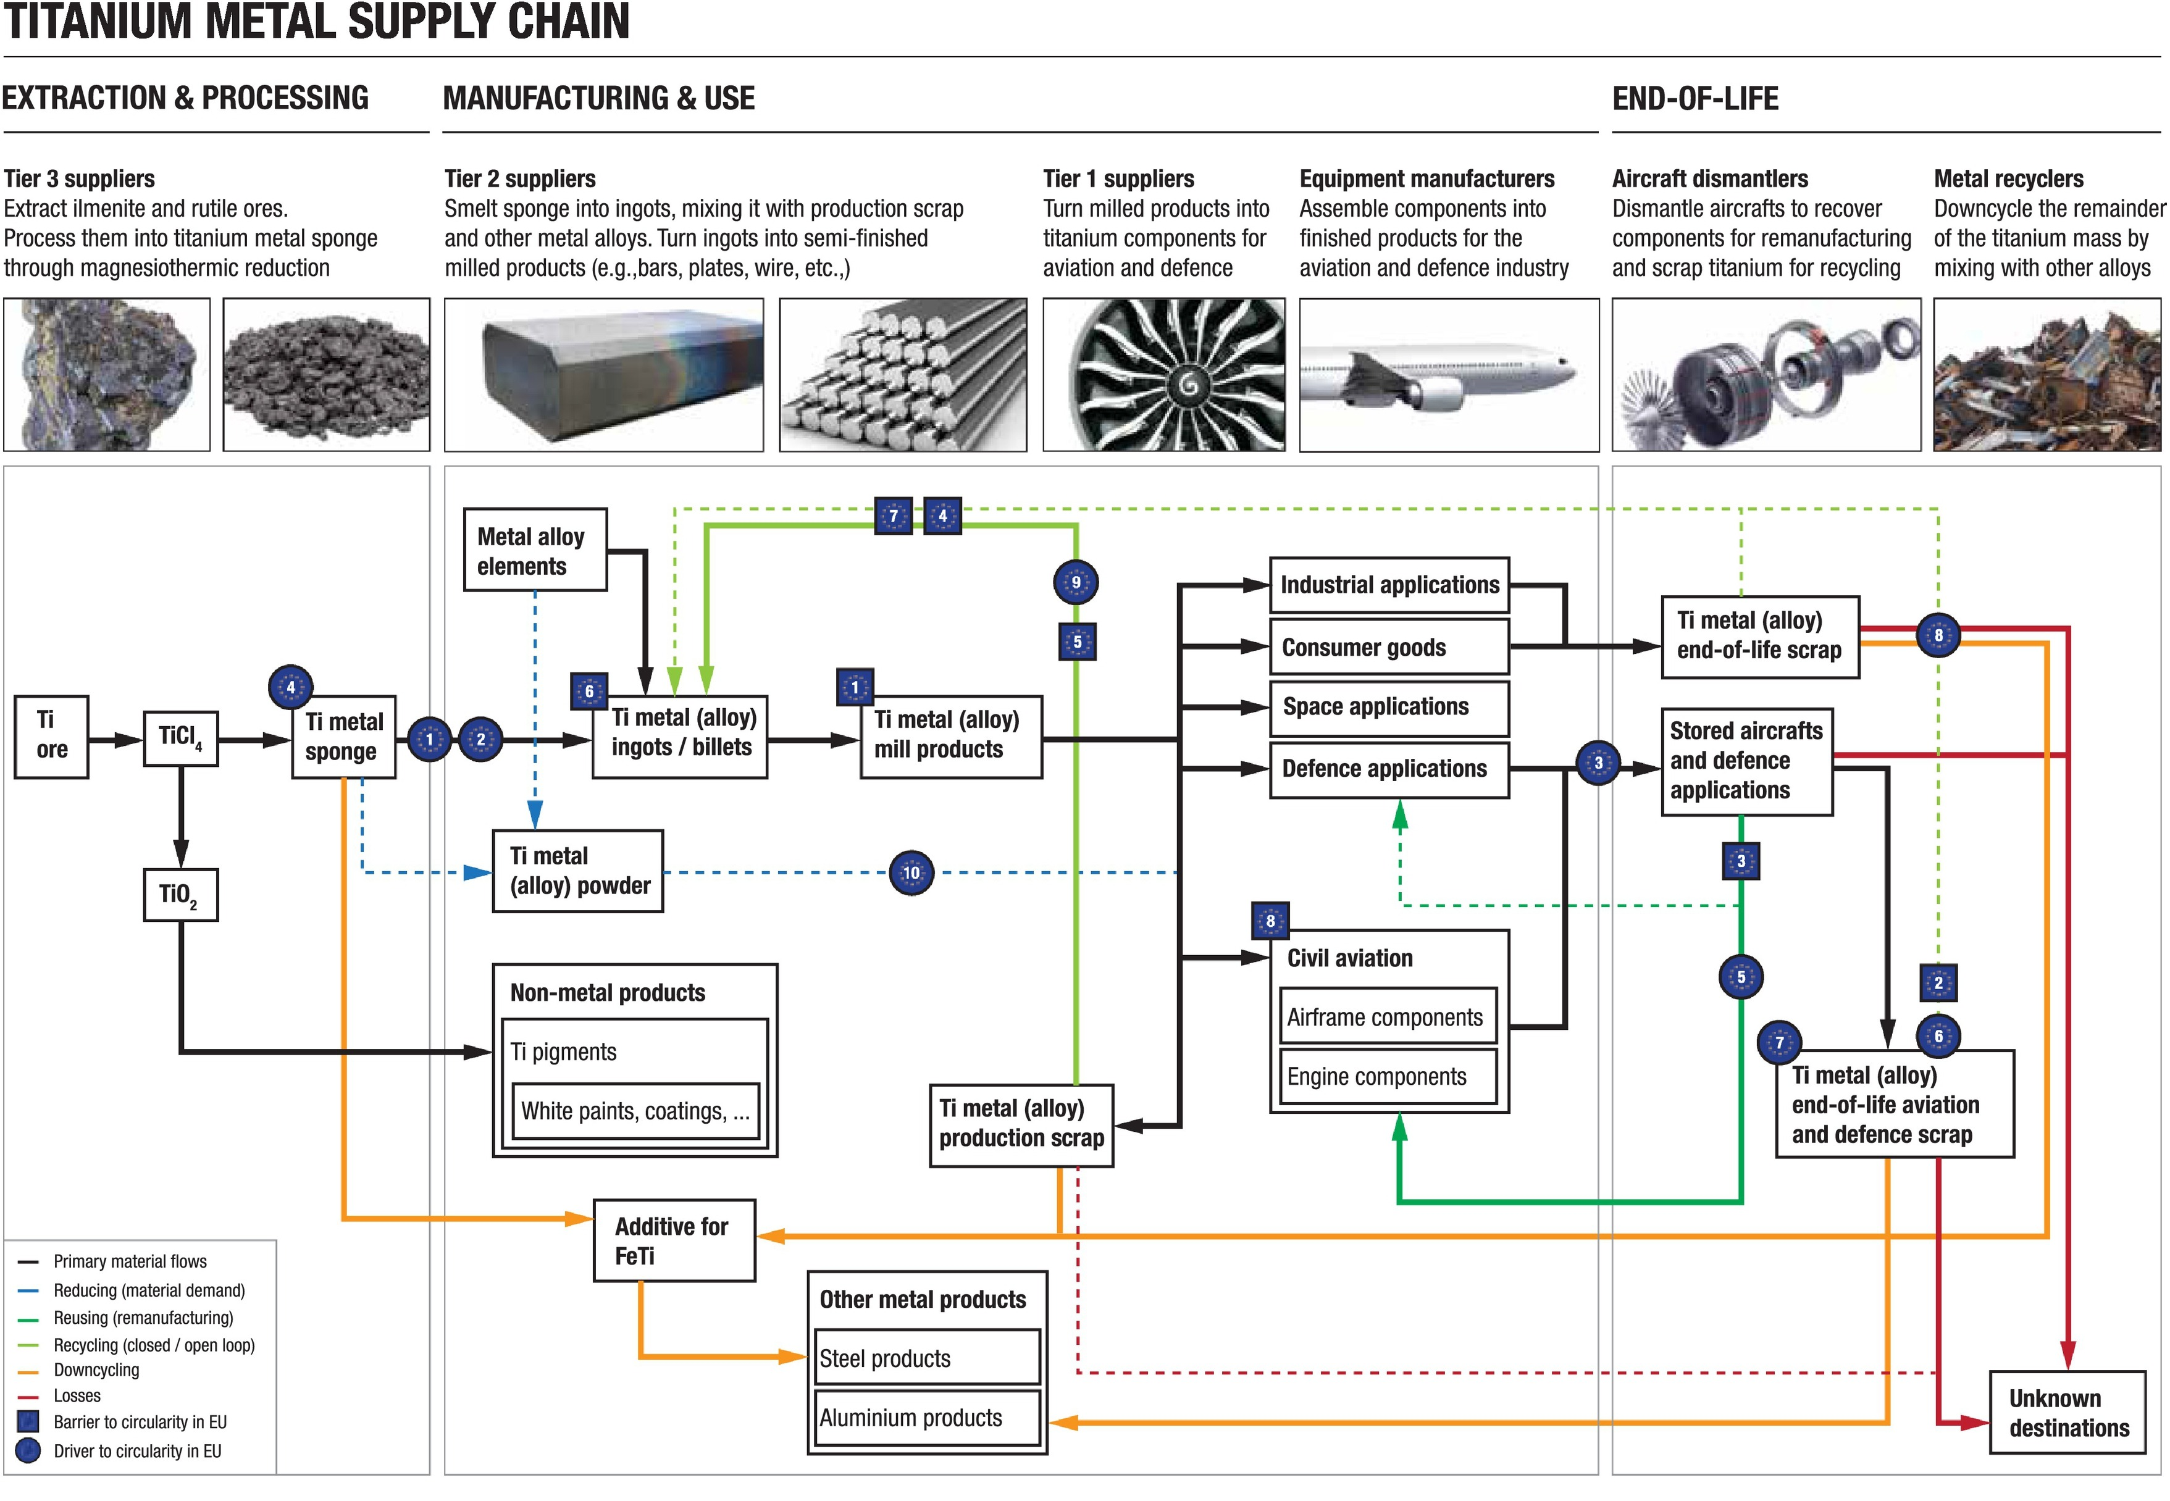
Friant et al.‘s (2020) Fortress Circular Economy
Notes:
All Rs included

Slide 22
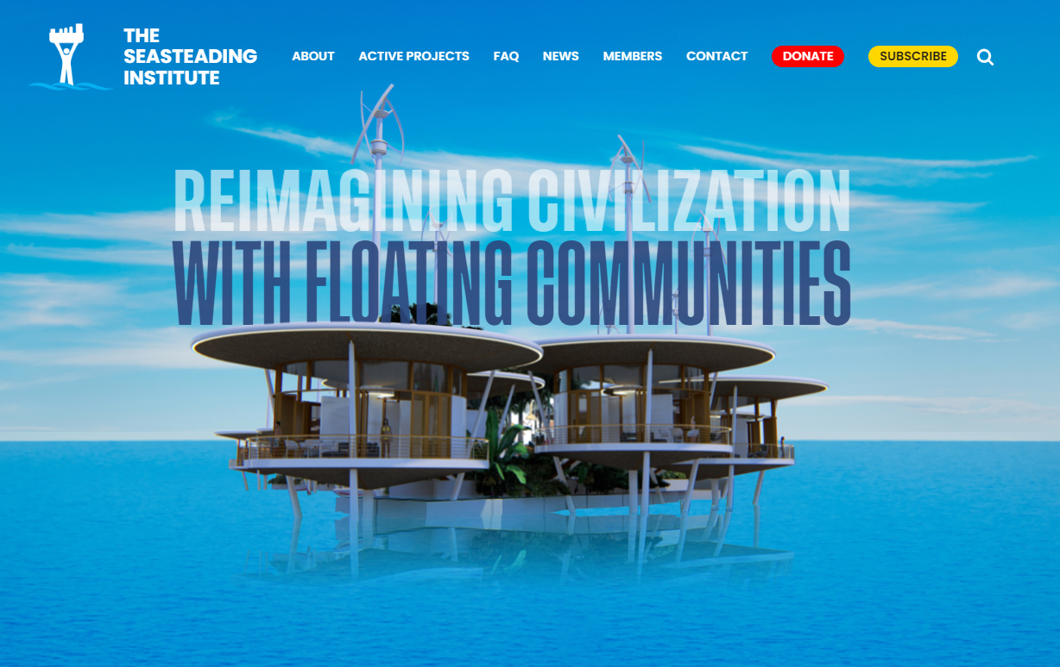
Friant et al.‘s (2020) Fortress Circular Economy
Notes:
All Rs included

Slide 23
Some often referred to predecessors

Slide 24
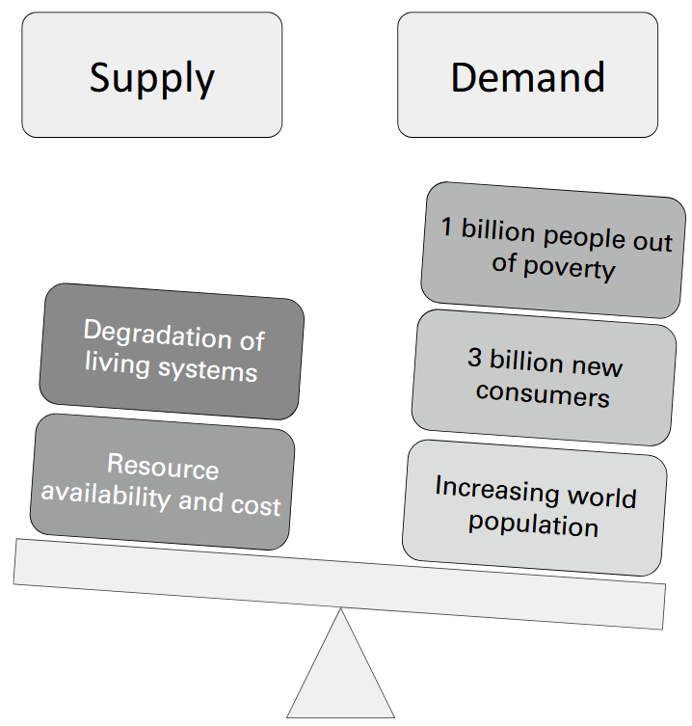
So it’s the EMF (alone)?
👉 many predecessors:
Industrial Ecology (& Symbiosis)
Cradle-to-Cradle Design (C2C)
Biomimicry
Performance Economy
Blue Economy
Regenerative Design
…

Slide 25
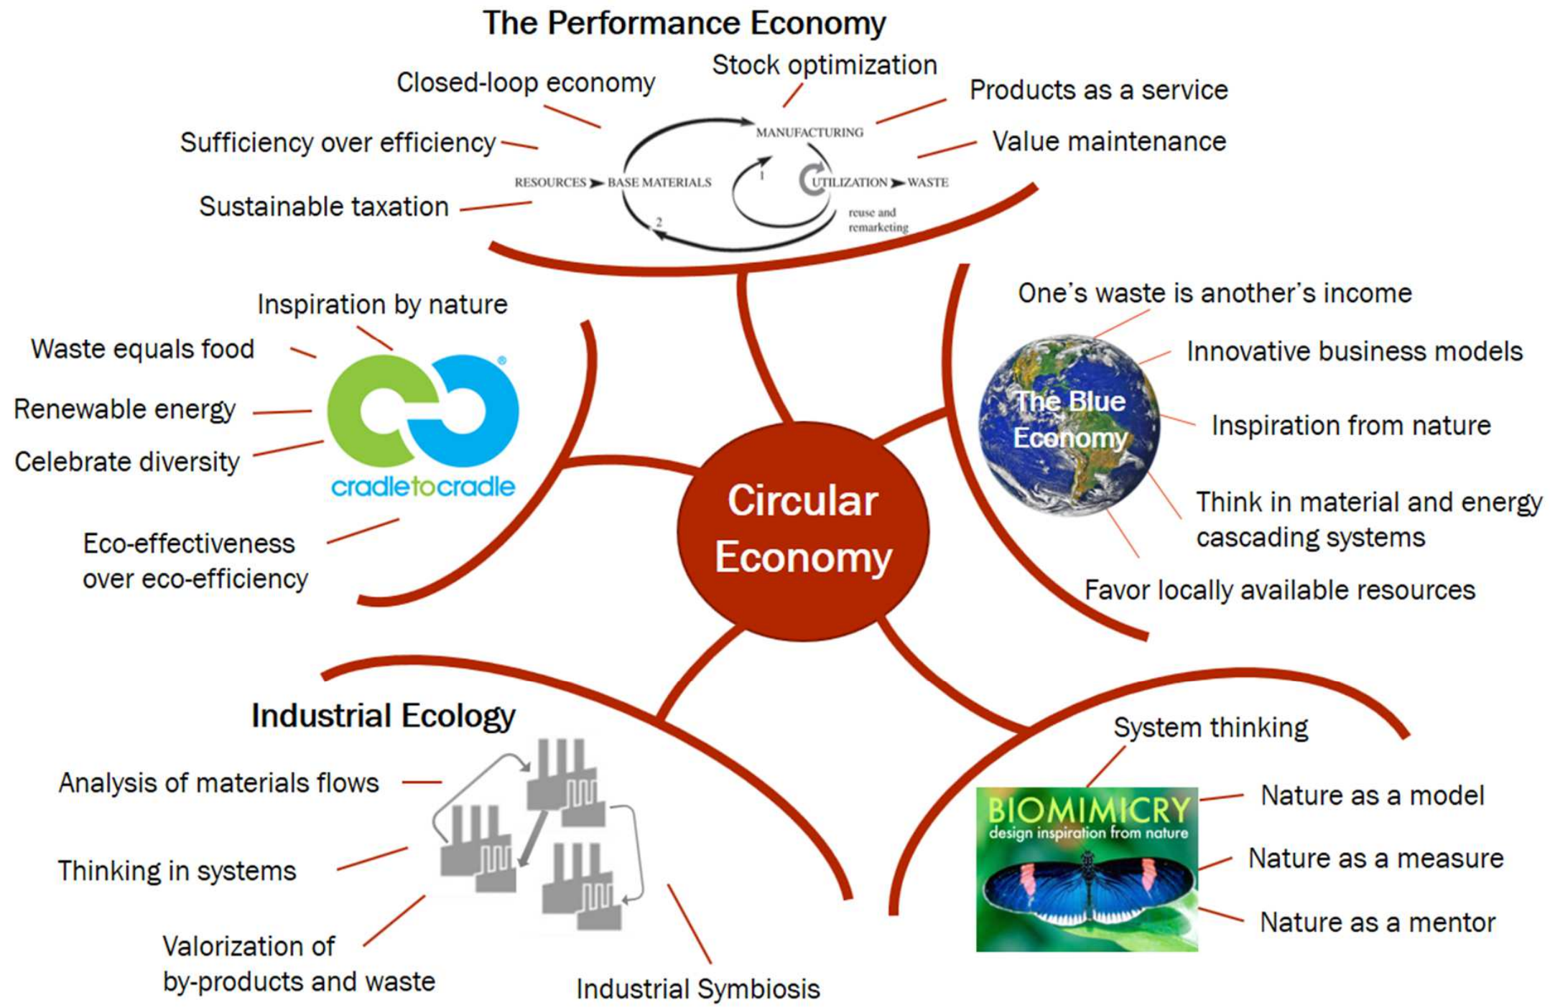
So it’s the EMF (alone)?

Slide 26
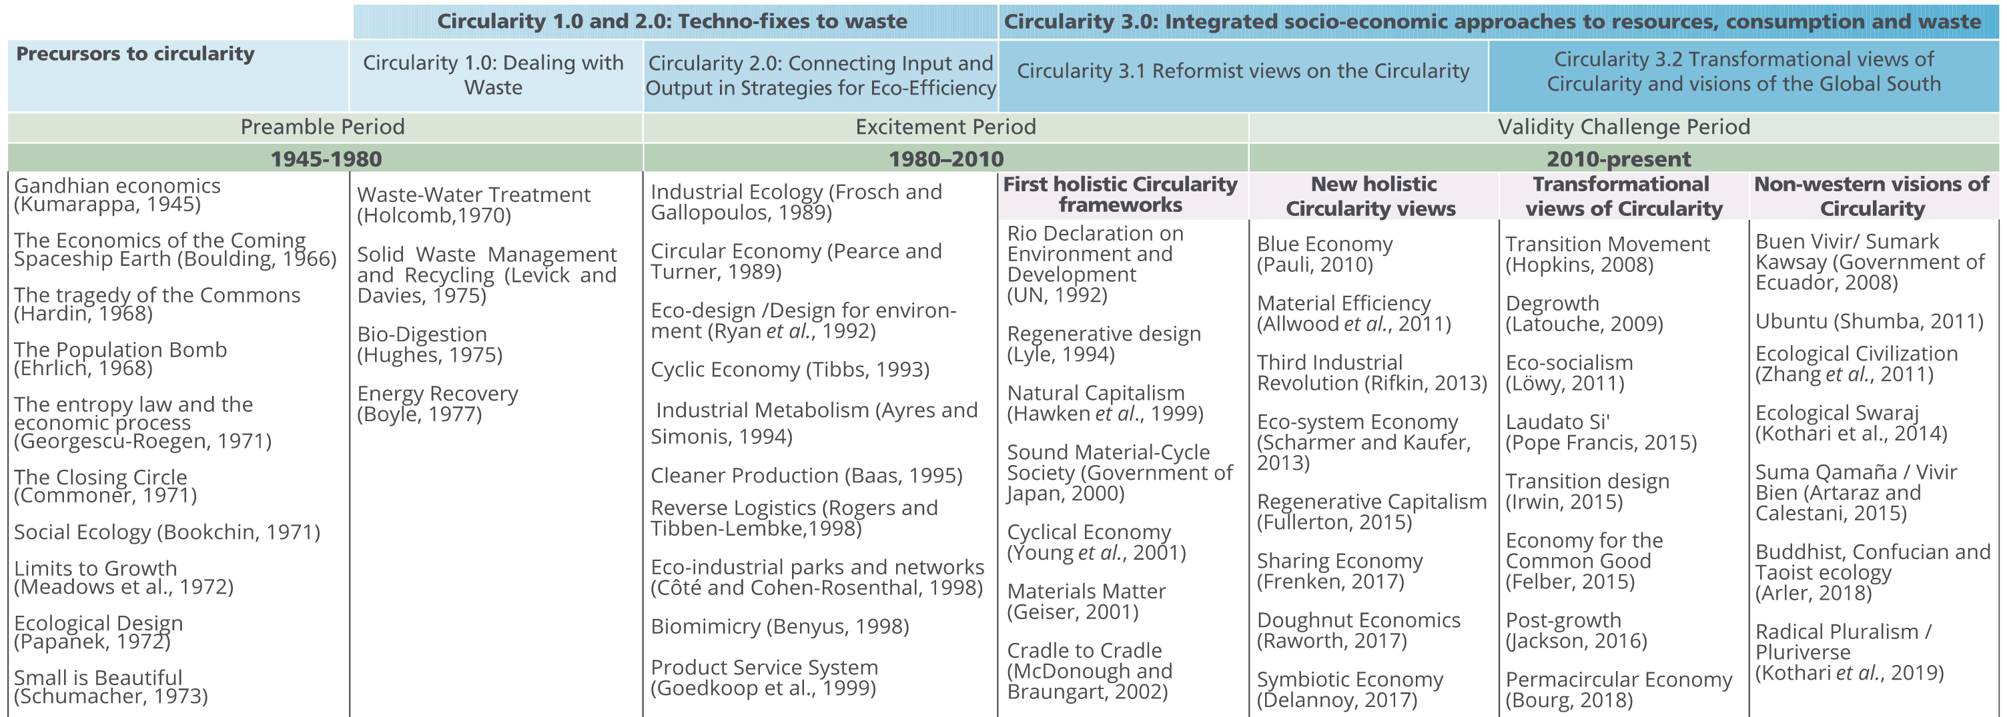
So it’s the EMF (alone)? Not really …

Slide 27
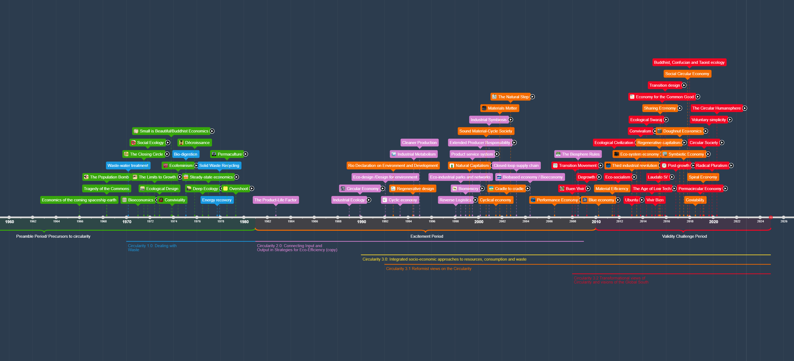
So it’s the EMF (alone)? Not really …

Slide 28
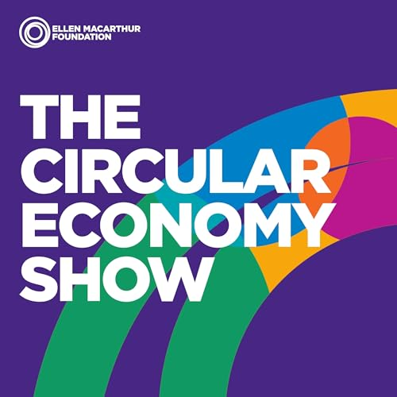
So it’s the EMF (alone)? Listening tip
EMF Podcast on “The Origins of the circular economy”

Slide 29
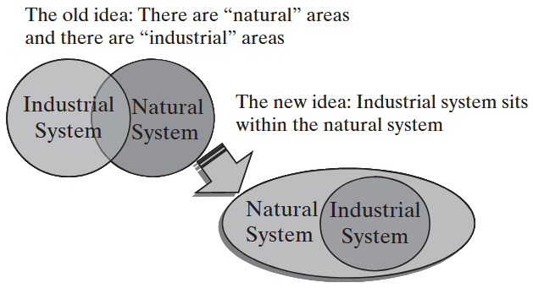
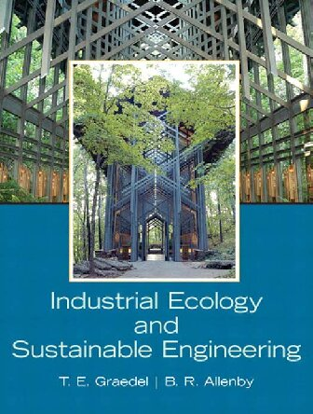
A) Industrial Ecology ~ 1970+
👉 industrial systems = part of larger ecological systems
Focus: on material & energy flows
Goal: Minimise environmental impact by mimicking natural ecosystems
closed-loop systems to recycle, reuse, and repurpose waste
Life Cycle Thinking: Evaluates environmental impacts across a product’s life cycle
from production to disposal
Energy Efficiency: Reduces energy use and prioritises renewable sources

Slide 30
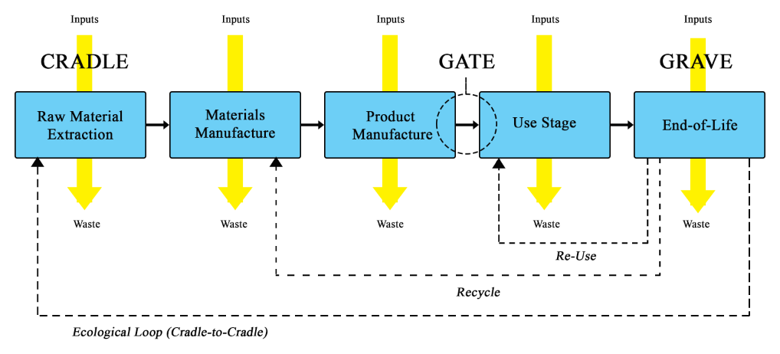
@ Life Cycle Assessment (LCA): Cradle 2 Grave

Slide 31
A) Industrial Ecology – a definition
“The concept requires that an industrial ecosystem be viewed not in isolation from its surrounding system, but in concert with them. It is a systems view in which one seeks to optimize the total materials cycle from virgin material, to finished material, to component, to product, to obsolete product, and to ultimate disposal. Factors to be optimized are resources, energy and capital.” (Graedel & Allenby, 1995)
“It focuses on the use of technology to reduce environmental impacts and reconcile human development with environmental stewardship” (International Society for Industrial Ecology, 2024)

Slide 32
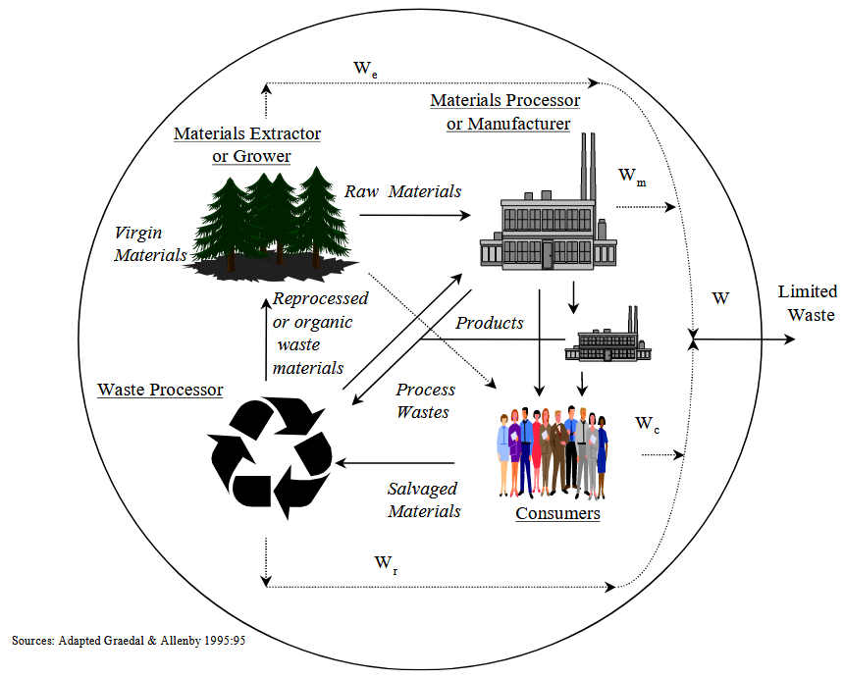
A) Industrial Ecology

Slide 33
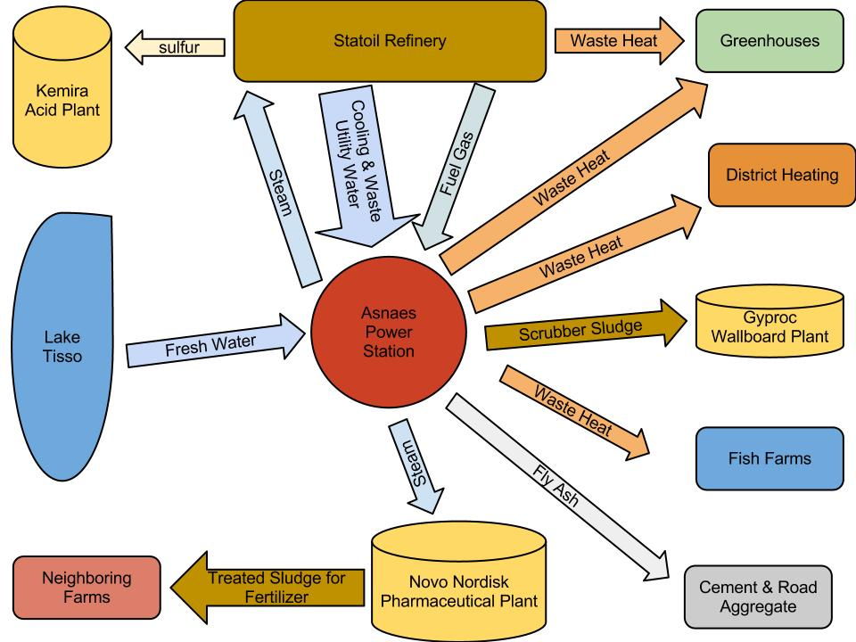
A) Industrial Ecology: From Ecology to Symbiosis
👉 collaboration between industries to share resources
Kalundborg Eco-Industrial Park
Focus on materials, energy, water, or by-products
waste from one process becomes input for another
reducing environmental impact & improving resource efficiency
Notes:
Kalunborg: Dänemark – Region Seeland zwischen Odensee / Kopenhangen

Slide 34
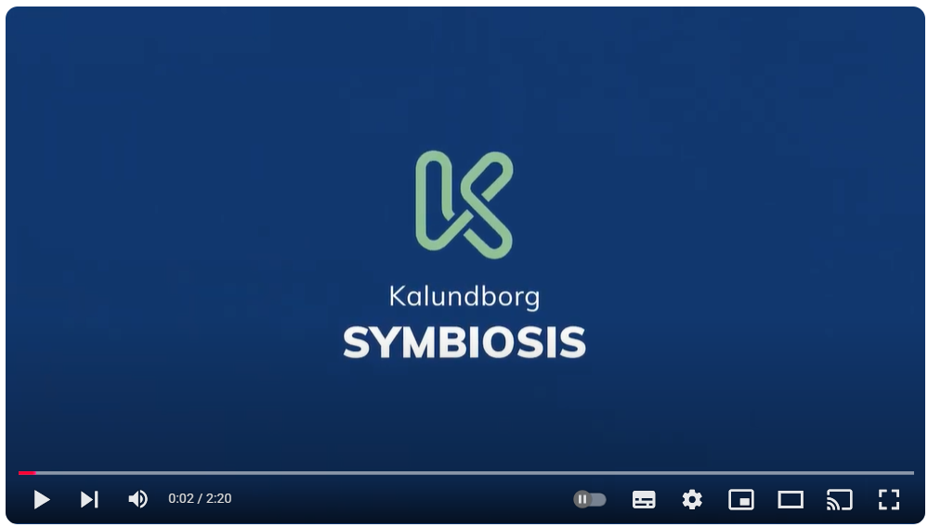
A) Industrial Ecology: From Ecology to Symbiosis

Slide 35
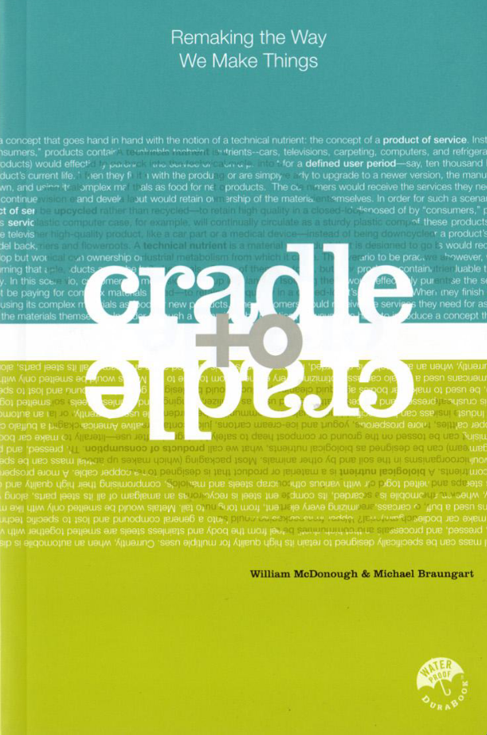
B) Cradle-to-Cradle (C2C) ~ 2000+
design philosophy for regenerative systems: 👉 "waste = food“
Products designed for continuous cycles:
returned to nature (biological cycles) or
perpetually reused in industrial processes (technical cycles)
Focus on: Eco-Effectiveness not Eco-Efficiency
non-toxic, sustainable materials
renewable energy in production
Water stewardship
Notes:
nutrients

Slide 36
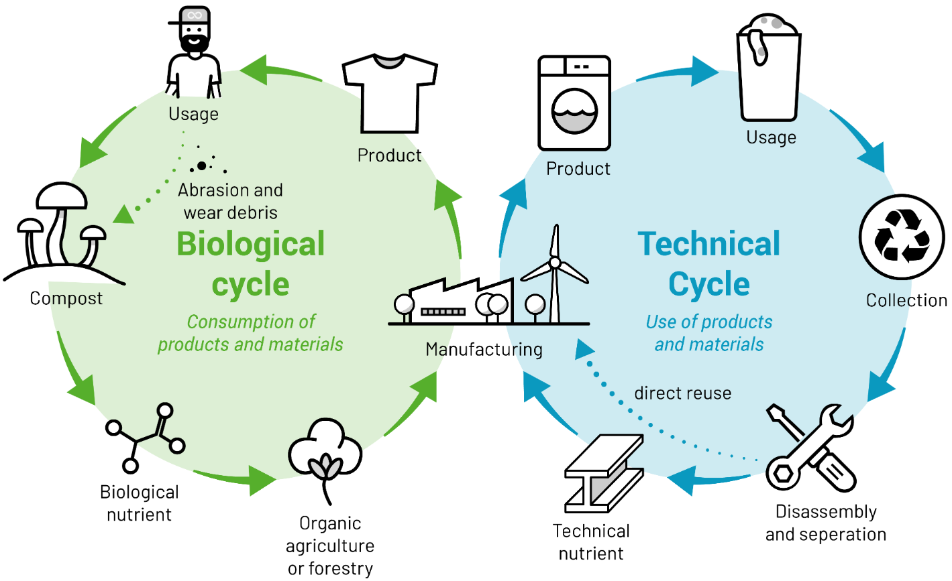
B) Cradle-to-Cradle (C2C)

Slide 37
B) Life Cycle Assessment vs. Cradle-to-Cradle (C2C)

Slide 38
B) Cradle-to-Cradle (C2C): Effect over efficiency?
Eco-Efficiency: 👉 reduce environmental impact
Doing more with less
Minimising resource use and waste
Incremental improvements
Eco-Effectiveness: 👉 systems &products = regenerative & beneficial
Create "waste equals food" cycles
eliminate waste entirely

Slide 39
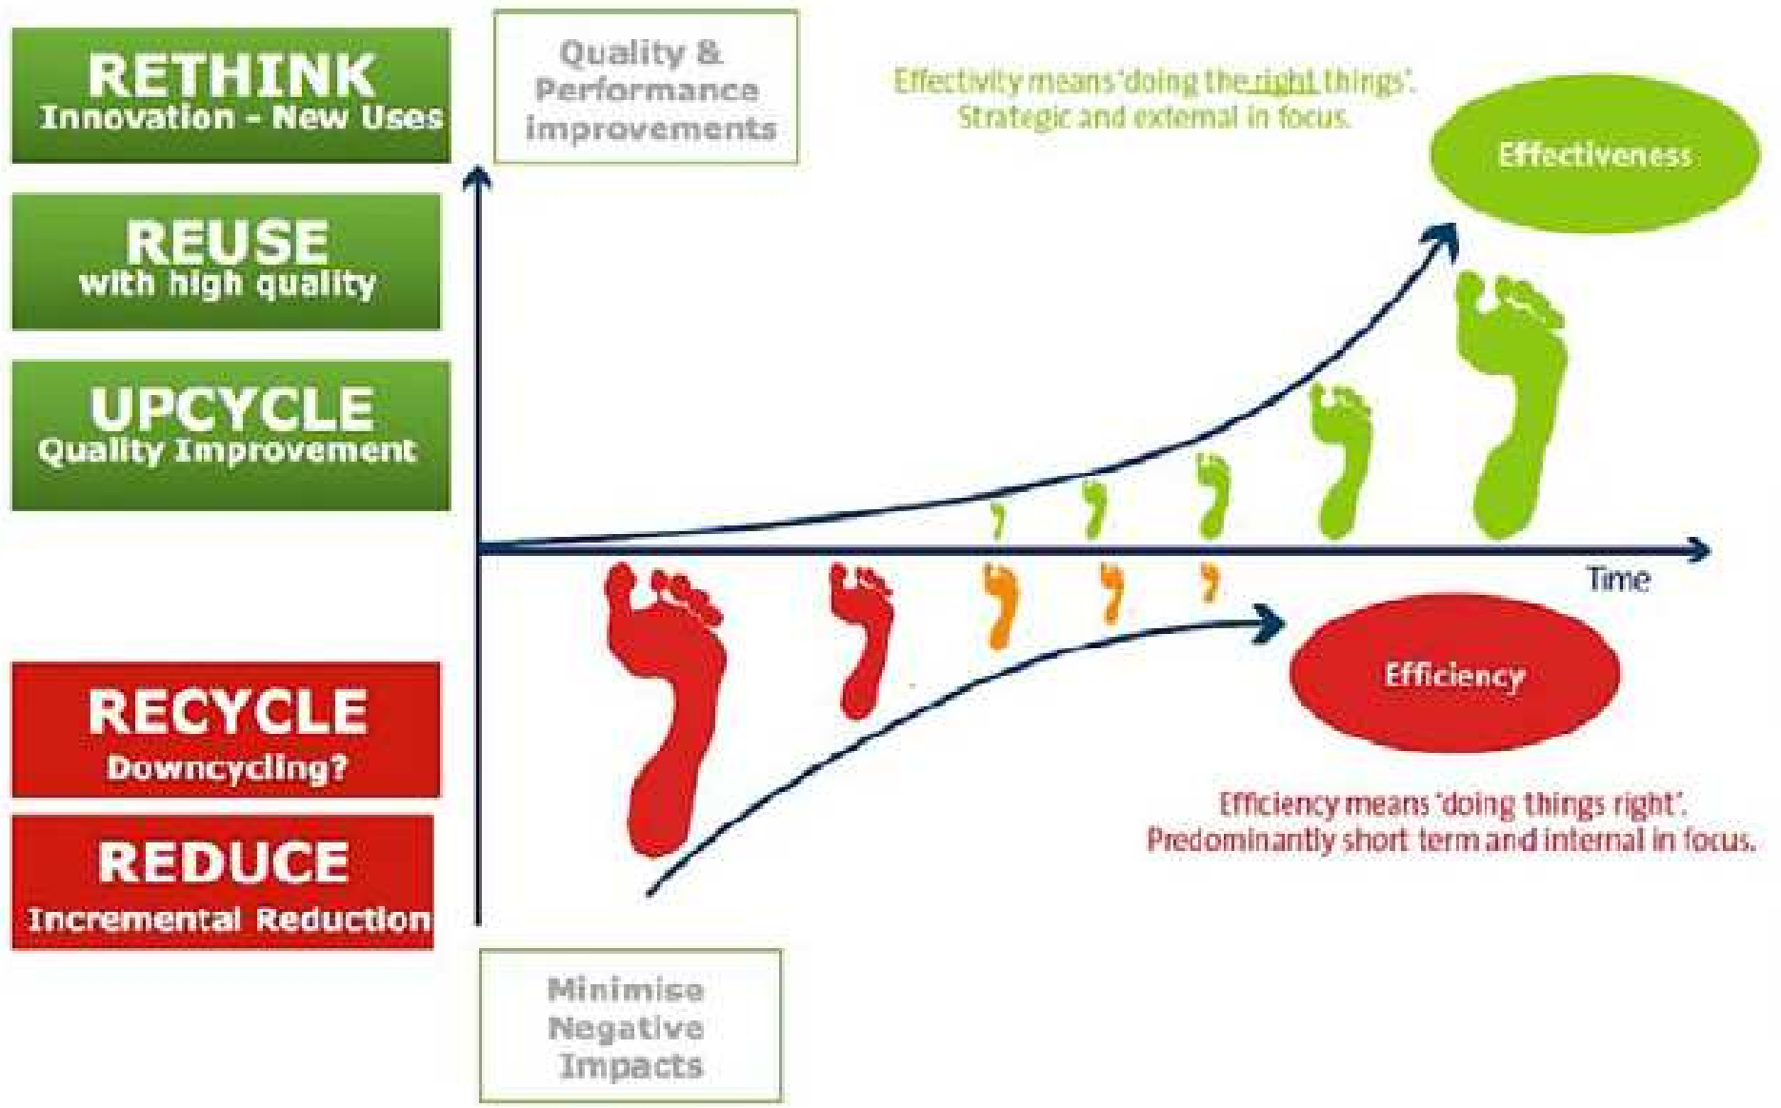
B) Cradle-to-Cradle (C2C): Effect over efficiency?

Slide 40
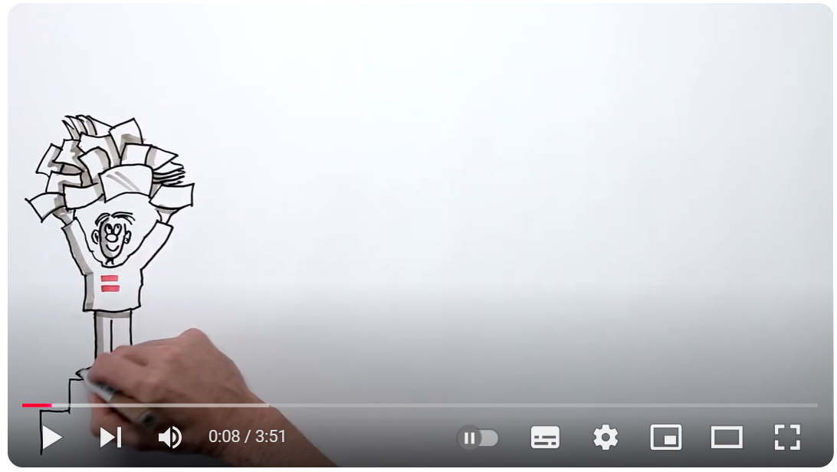
B) Cradle-to-Cradle (C2C): An Example from not so far away

Slide 41
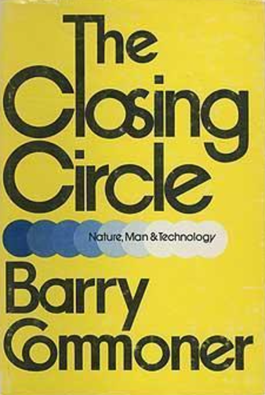
C) Biomimicry ~1960+
Barry Commoner’s (1971) “Four Laws of Ecology”:
Everything is connected to everything else.
Everything must go somewhere.
There is no “away” to which things can be thrown.
👉 Nature knows best.
There is no such thing as a free lunch.
Notes:
@ free lunch: all actions have ecological costs

Slide 42
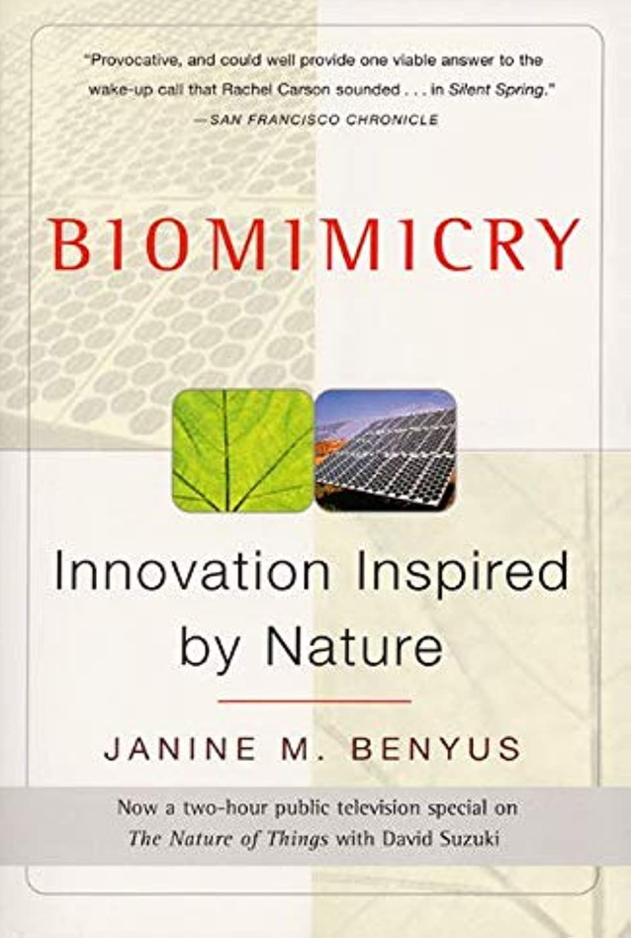
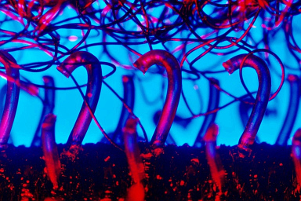
C) Biomimicry ~1960+
👉 learning from nature’s designs and processes
Natural inspiration👉 “Emulation”: Ecosystem = model
Efficient resource use
New interpretations (~ 1990+):
Zero waste philosophy
Waste = food
Closed Loop Systems
Notes:
1997

Slide 43
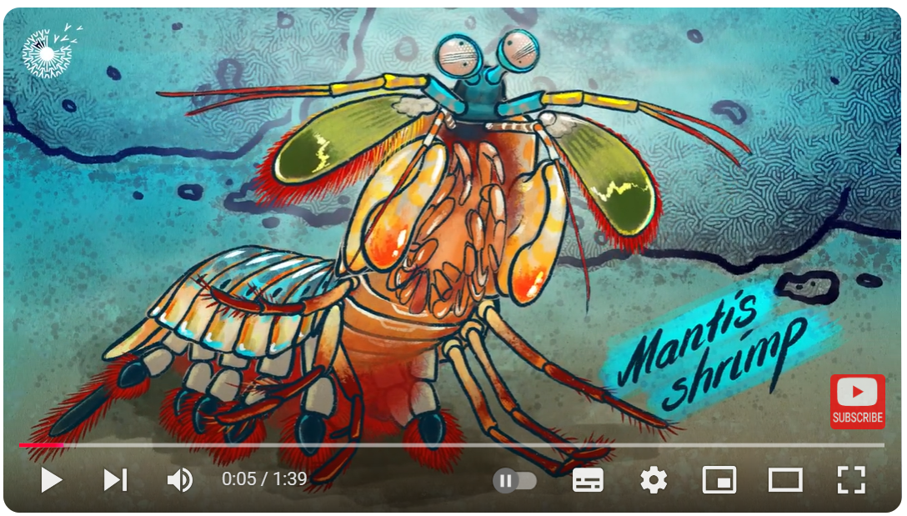
C) Biomimicry: An efficiency example

Slide 44
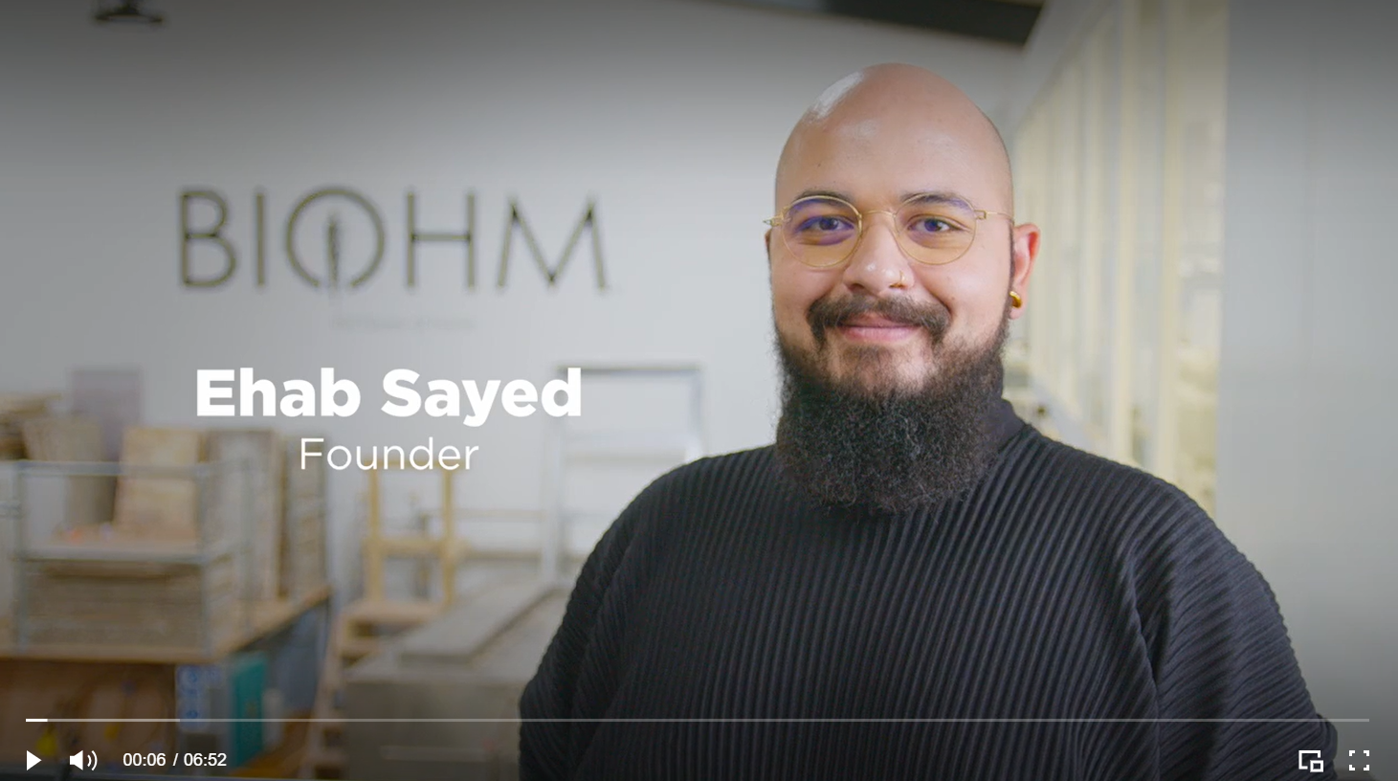
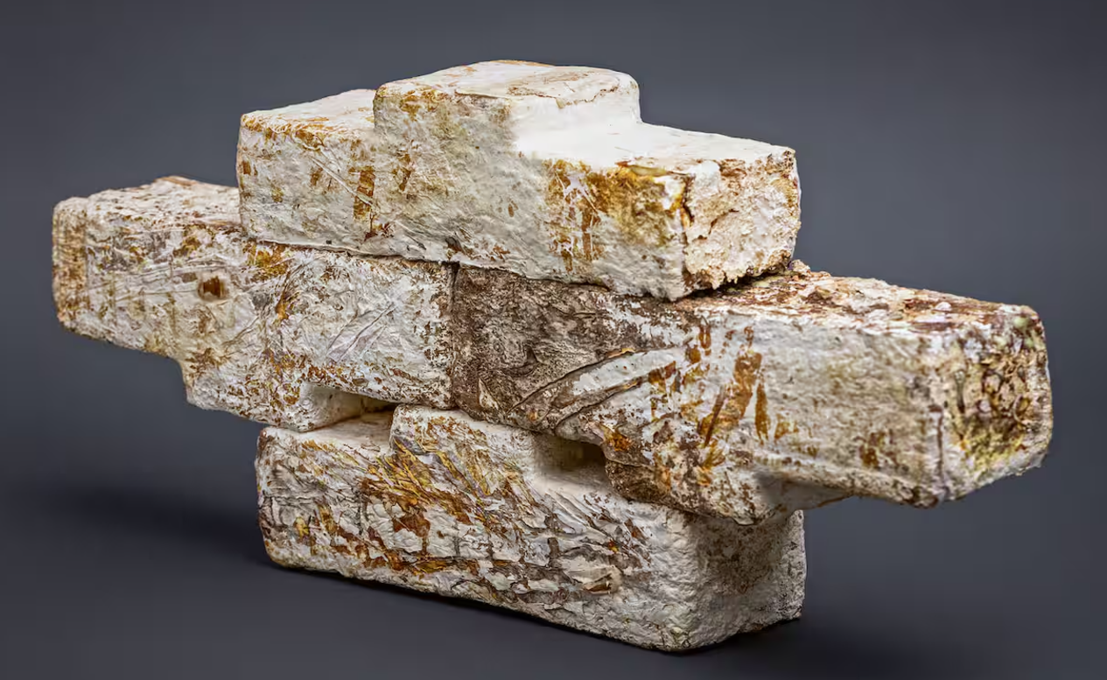
C) Biomimicry: A more circular example

Slide 45
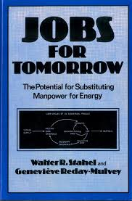
D) Performance Economy ~1980+
👉 prioritising access over ownership selling services rather than products
Shift from a "linear economy" (make, use, dispose):
maintenance, repair, reuse & remanufacturing
Goals:
Reduce resource consumption & waste
Maximise resource productivity & value retention
Encourage leasing, sharing, or renting
Minimise emissions & waste 👉 keeping products longer in use

Slide 46
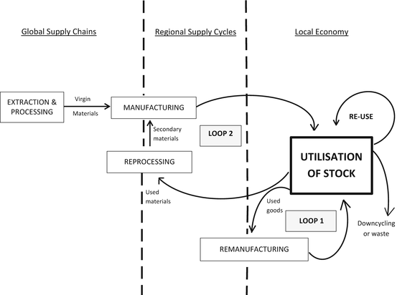
D) Performance Economy

Slide 47
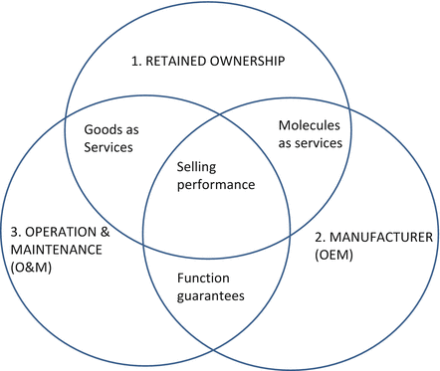
D) Performance Economy: Focus on “performance”
👉 Continued ownership is cost-efficient:
reuse, repair and remanufacture without a change of ownership save double transaction costs

Slide 48
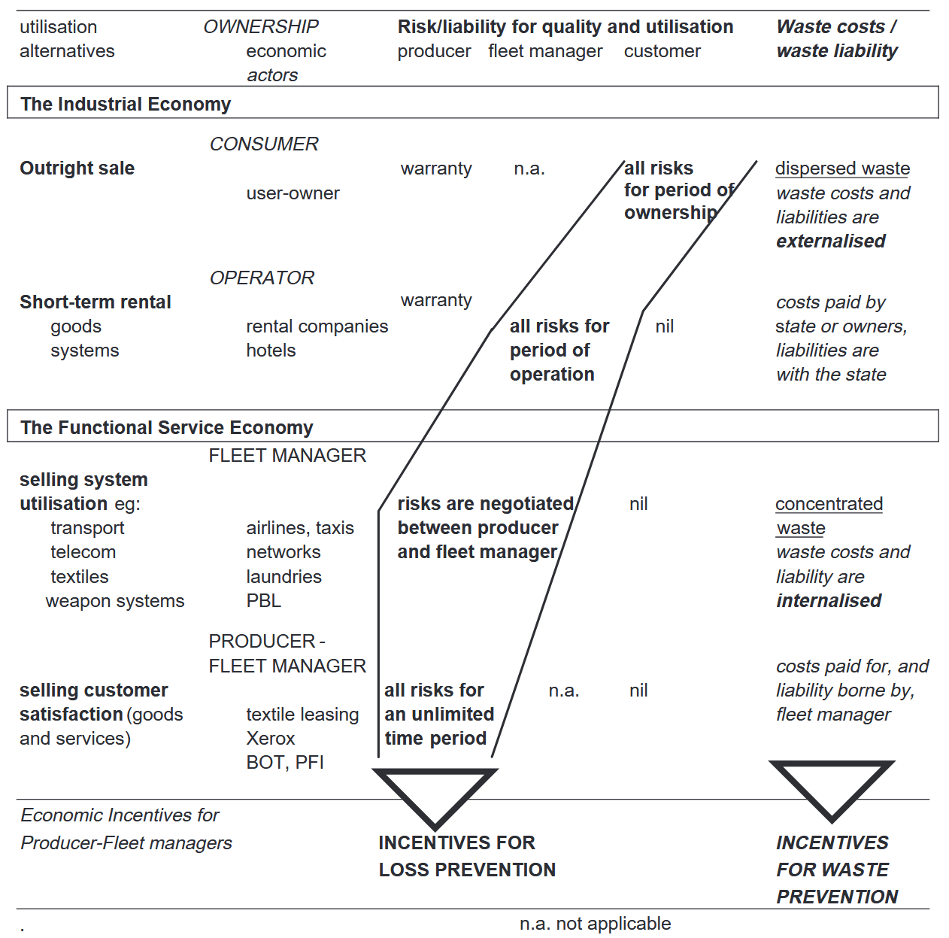
D) Performance Economy: Focus on “performance” (= service)
👉 Continued ownership is cost-efficient:
reuse, repair and remanufacture without a change of ownership save double transaction costs

Slide 49
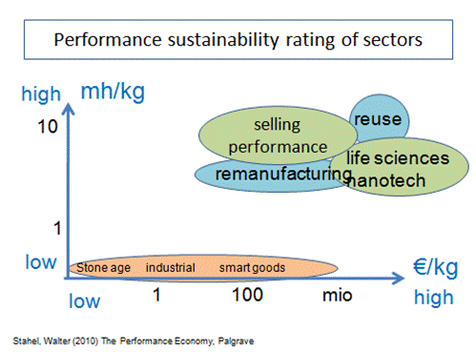
D) Performance Economy: Why focus on jobs?
Lake Economy Model vs. river Economy:
Retain, reuse, refurbish goods
Stock management 👉 retain value
Principles:
Product life extension: repair, maintain, remanufacture
work intensive 👉 mh/kg
Service oriented business models
Resource circulation

Slide 50
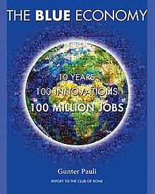
E) Blue Economy (Pauli, 2010)
👉 sustainable economic model inspired by natural systems,
efficient resource use & zero waste
Principles:
Mimic Nature
Local Resource Use 👉 minimise transportation
Innovation-Driven:
creative, low-cost, “open source” solutions to address local challenges
Zero Waste: by-products = valuable inputs
Social & Economic Benefits:
Create jobs, improve livelihoods& enhance community well-being
Notes:
Gunter Pauli 2010

Slide 51

E) Blue Economy: Kind of influential …

Slide 52

F) Regenerative Design ~1970+
👉 Permaculture: design system for creating sustainable human habitats by mimicking patterns & relationships found in nature
Principles:
Care for the Earth: Preserve & regenerate natural systems
Care for People: Ensure well-being & equitable access
Fair Share: Redistribute surplus to meet the needs of all living systems
🔎 Energy efficiency, biodiversity & closed-loop resource use:
Agriculture, water management, energy systems, architecture & community living

Slide 53

F) Regenerative Design ~1970+
🔎 Architecture: human systems = in harmony with ecosystem
Main Focus:
Restore & enhance ecological & social health
„moving beyond sustainability“: do no harm
Goal:
Regenerate natural resources & supporting human needs
Neotechnical age: integration of ecological principles & modern technologies 👉 systems in harmony with nature

Slide 54


F) Regenerative Design ~1970+

Slide 55


F) Regenerative Design: Lyle’s Center
“The unifying concept of the Center is the human ecosystem”
Notes:
Design team:
16 acres of land
20 Students
2 visiting scholars
1 resident advisor

Slide 56


F) Regenerative Design: Lyle’s Center
Notes:
Design team:
16 acres of land
20 Students
2 visiting scholars
1 resident advisor

Slide 57

F) Regenerative Design: Today

Slide 58
Outlook

Slide 59
Wrap it up

Slide 60

Till next session:
https://youtu.be/v_Xf3h5b3Y4

Slide 61


So long & cheerio!

